Slide 1
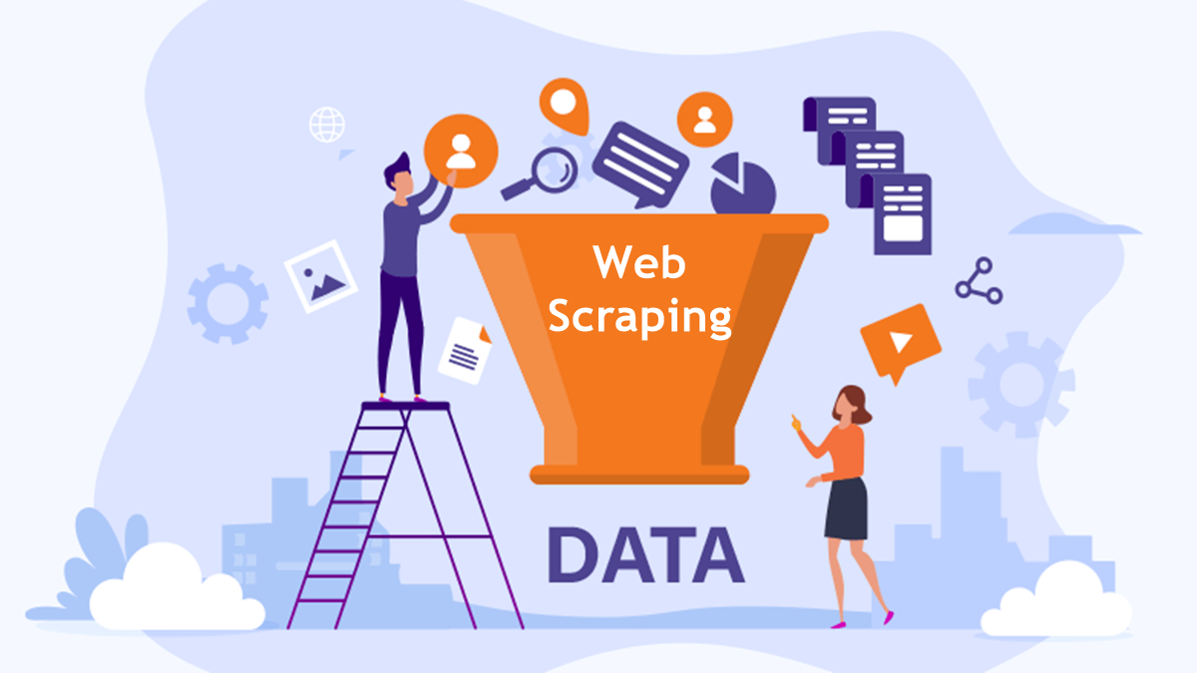
WEB SCRAPING: BUILDING A STREAMLIT APP

Slide 2
Presented By
Mohd Farman
Delhi, New Delhi
Data Science Trainee, Meta Scifor Technology
Cyber Review Analyst, Epiq Global
MCA, Galgotias University 2023
BCA, Al Falah University 2021

Slide 3

INTRODUCTION TO WEB SCRAPING
In this presentation, we will explore web scraping using a Streamlit app. Web scraping allows us to extract information from websites effortlessly. By the end, you will understand the basics of data extraction and how to implement it using python and streamlit.

Slide 4
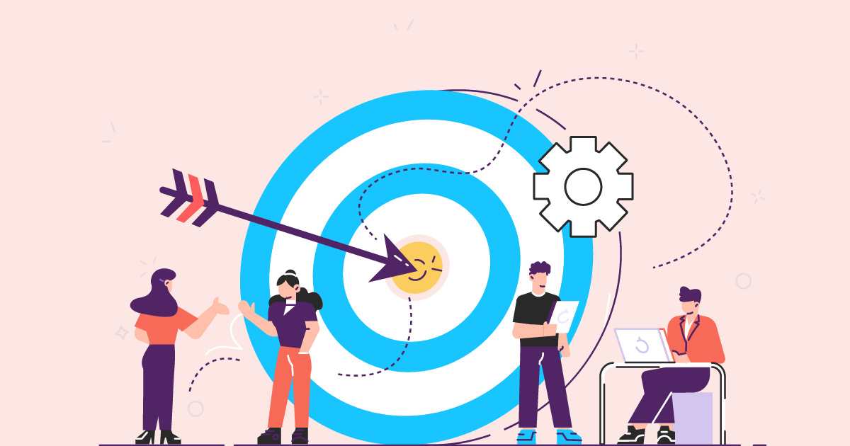
Objectives
Build a simple web scraping tool.
Extract text, links, and images from web pages.
Provide easy options to download scraped content as PDF or DOCX files.

Slide 5

WHAT IS STREAMLIT?
Streamlit is an open-source app framework for Machine Learning and Data Science projects. It allows developers to create interactive web applications with minimal effort. Streamlit simpliﬁes the process of building and deploying applications, making it a great choice for data extraction tasks.

Slide 6
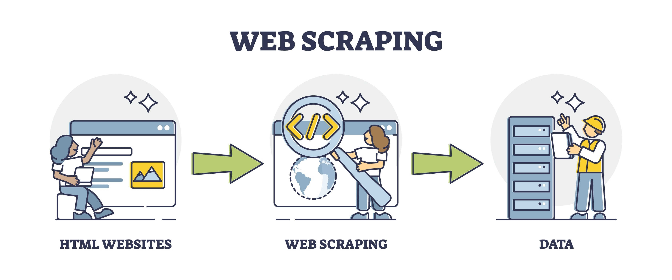
UNDERSTANDING OF WEB SCRAPING
Web scraping is an automated technique used to extract large amounts of data from websites. It involves sending HTTP requests to a website, retrieving the HTML content, and parsing it to extract the desired information.

Slide 7
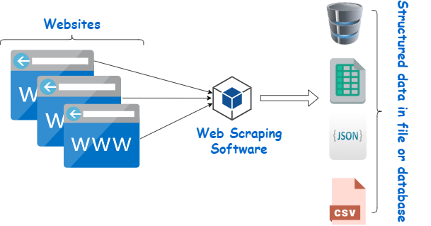
HOW WEB SCRAPING WORKS

Slide 8
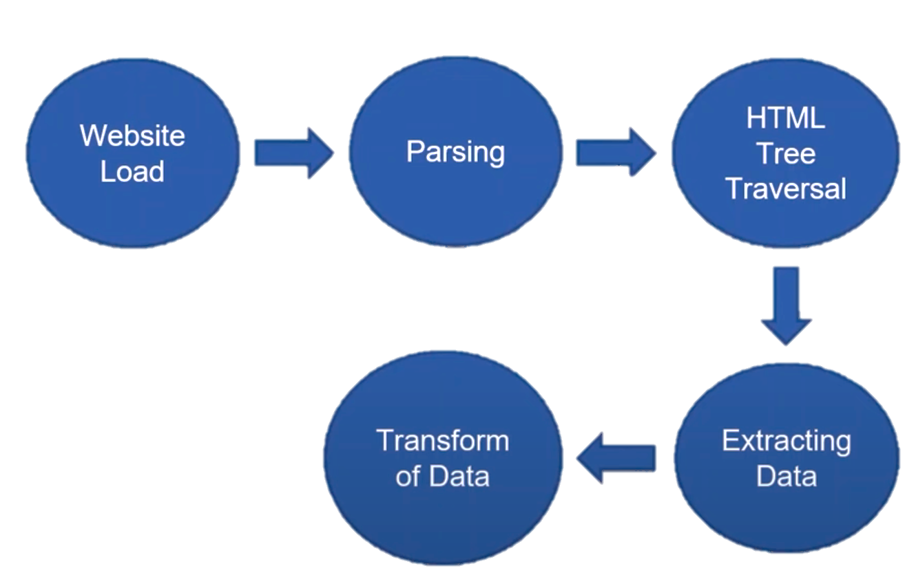
COMPONENT OF WEB SCRAPING

Slide 9
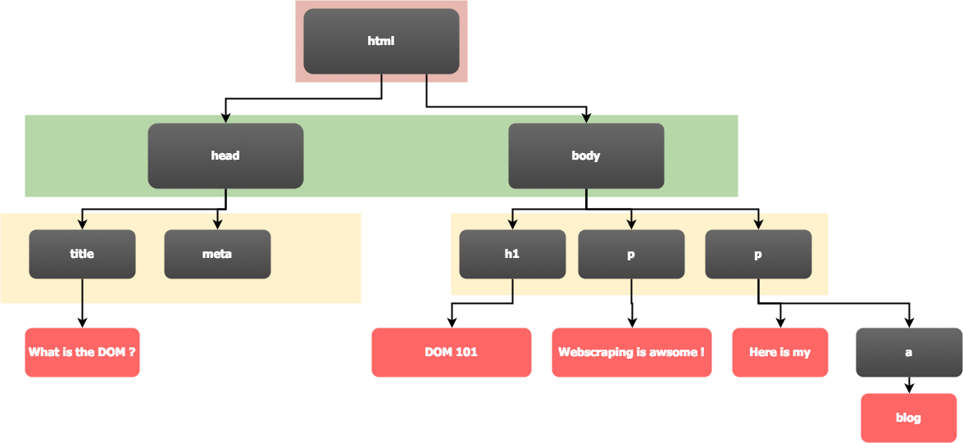
COMPONENT OF WEB SCRAPING

Slide 10



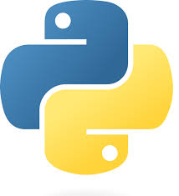
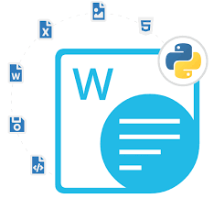


TE TECHNOLOGIES USED
Programming Language: Python
Libraries:
- Streamlit: For building the interactive web app.
- Requests: For making HTTP requests to retrieve
website content.
- BeautifulSoup: For parsing HTML and extracting data.
- FPDF: For generating PDFs.
- python-docx: For creating Word documents.
IDE: VS Code

Slide 11

SETTING UP YOUR ENVIRONMENT
To start building your Streamlit app, you need to set up your Python environment. Install necessary libraries such as streamlit, requests, and Beautifulsoup. This setup will allow you to run the app and perform web scraping efficiently.

Slide 12
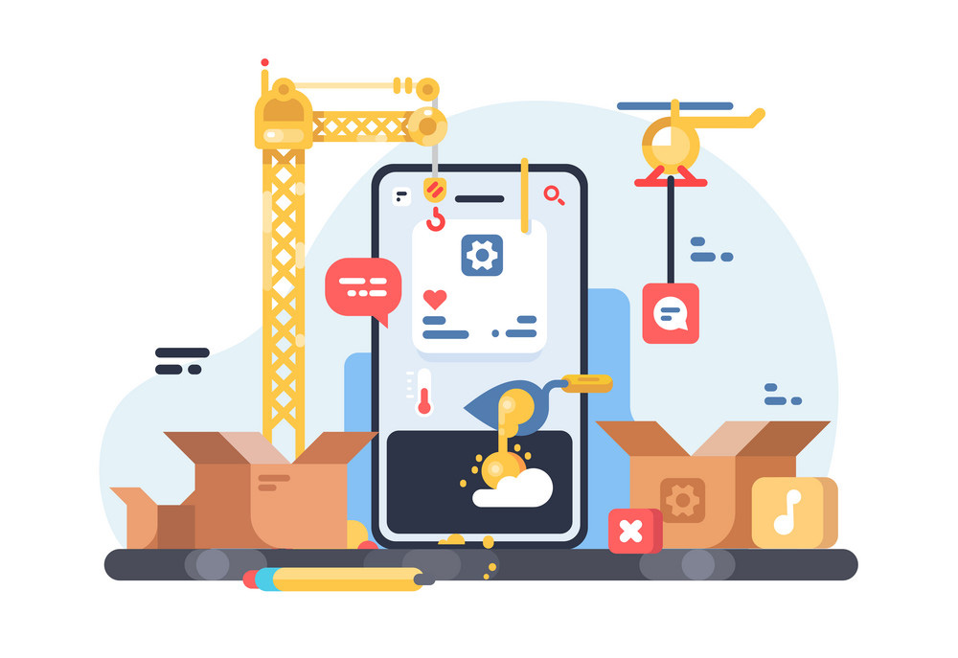
CREATING A BASIC STREAMLIT APP
Begin by creating a basic Streamlit app using the command streamlit run app.py. In your app, you can use Streamlit Components to create user inputs, display outputs, and manage the layout. This foundation will support your web scraping functionalities.

Slide 13
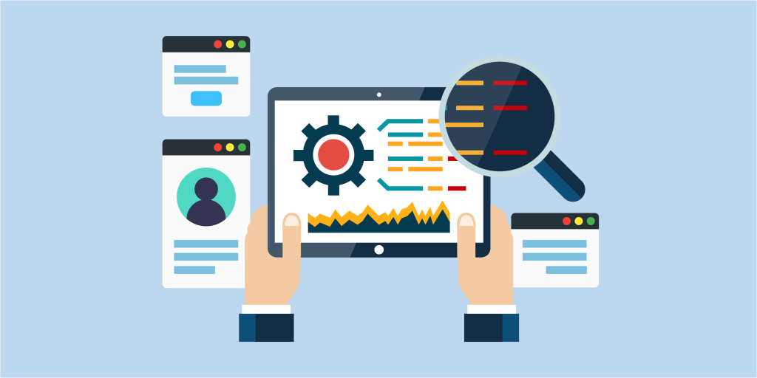
RESULTS:DISPLAYING EXTRACTED DATA
Show the user interface, including input fields, checkboxes, and output display.
Highlight the dark mode toggle and scraped content (e.g., titles, headers, images).
Demonstrate the download functionality with PDF and DOCX examples.

Slide 14
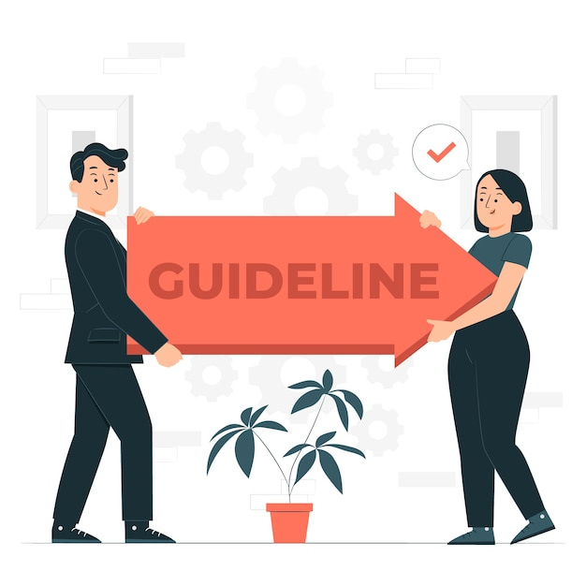
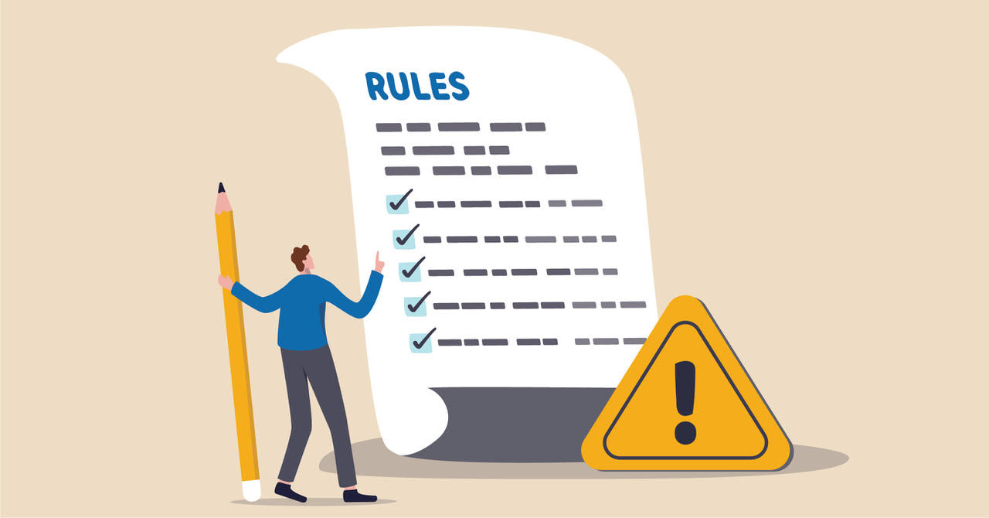
BEST PRACTICES FOR WEB SCRAPING
When scraping data, always follow ethical guidelines. Respect the robots.txt website's ﬁle, avoid overloading servers with requests, and ensure compliance with legal regulations. This ensures responsible data extraction and maintains good relationships with website owners.

Slide 15
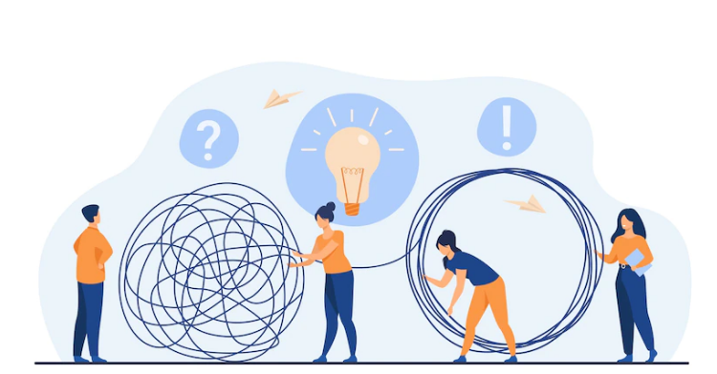
COMMON CHALLENGES
Web scraping can present challenges such as comments, changing website structures, and IP blocking. To overcome these issues, consider implementing proxies and error handling in your Streamlit app to ensure a smooth data extraction process.

Slide 16
CONCLUSION
In conclusion, building a Streamlit app for web scraping can signiﬁcantly simplify the data extraction process. By leveraging the right tools and following best practices, you can create effective applications that gather valuable information from the web e ortlessly.

Slide 17
References and Ressources
Streamlit Documentation
BeautifulSoup Documentation
FPDF Documentation
python-docx Documentation

Slide 18

Thanks!
Do you have any questions? Mohd.farman@email.com
+91 9718936052

